Slide 1
PCA – Interpretation
Different types of constrains
Varimax rotation
Notes:
We will see how different types of constraints and Varimax rotation can be used to increase the interpretation of the weights.

Slide 2
Interpret the weights
Component matrix
 | PC1 | PC2
Diastolic BP | -0.53 | -0.46
Systolic BP | -0.5 | -0.52
Weight | 0.48 | -0.52
Height | 0.49 | -0.5
PC1 = -0.53*DBP + (-0.5)*SBP + 0.48*Weight + 0.49*Height
Notes:
In part 1, we retain only the first two principal components so we can focus on the weights for the first two components. Now we try to interpret the meaning of these weights.
Recall that these weights are used as coefficients when we calculate the score for the first component and these specific values are the ones that generate maximal variance of the first component.
We can interpret the valued of the weights as how much each variable contributes to the linear combination. When we do this, we should focus on the absolute values and therefore ignore any negative signs. We see that the weights are quite similar, which means that all variables contribute to a similar extent when the scores of PC1 are computed. The negative signs for the weights associated with the diastolic and systolic blood pressure tell us that these variables are negatively correlated with PC1.
Let’s focus on standardized diastolic blood pressure values and the scores from principal component 1

Slide 3
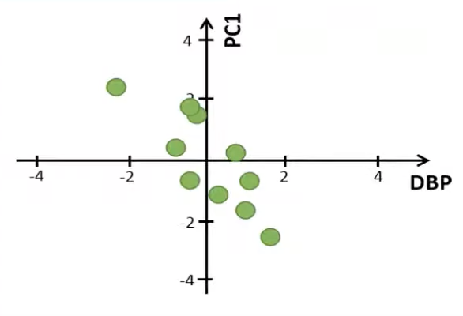
Interpret the weights
Data matrix (standardized data)
Score
Diastolic BP | Systolic BP | Weight | Height
(mm Hg) | (mm Hg) | (kg) | (cm)
0.93 | 0.82 | 0.21 | 0.36
-0.43 | -0.05 | 1.43 | 1.6
0.58 | 0.46 | 1.28 | 0.36
0.19 | 0.82 | -0.55 | -0.57
-2.05 | -1.98 | 0.06 | 0.51
-0.43 | -0.37 | -0.85 | -1.19
1.39 | 1.21 | -1.46 | -0.88
-0.7 | -1.19 | -0.39 | -0.73
0.81 | 0.62 | -0.85 | -0.88
-0.31 | -0.33 | 1.12 | 1.44
PC1 | PC2 | PC3 | PC4
-0.62 | -1.14 | -0.1 | -0.14
1.73 | -1.32 | -0.16 | 0.14
0.26 | -1.35 | 0.65 | 0
-1.05 | 0.06 | -0.09 | 0.46
2.35 | 1.68 | -0.28 | 0
-0.59 | 1.43 | 0.23 | 0.16
-2.47 | -0.06 | -0.4 | -0.17
0.41 | 1.51 | 0.32 | -0.24
-1.58 | 0.19 | 0.03 | -0.09
1.58 | -1 | -0.2 | -0.13
PC1 = -0.53*DBP + (-0.5)*SBP + 0.48*Weight + 0.49*Height
Notes:
Let’s focus on standardized diastolic blood pressure values and the scores from principal component 1. If we plot these two variables against each other, it seems to be a negative correlation between the two variables. This is what we would expect since there is a negative weight associated with the diastolic blood pressure when we calculate the scores for the principal component 1. If we instead would plot the standardize values of the body weight against the score of principal component 1

Slide 4
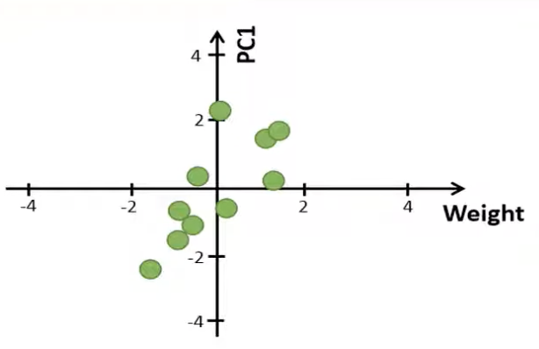
Interpret the weights
Data matrix (standardized data)
Score
Diastolic BP | Systolic BP | Weight | Height
(mm Hg) | (mm Hg) | (kg) | (cm)
0.93 | 0.82 | 0.21 | 0.36
-0.43 | -0.05 | 1.43 | 1.6
0.58 | 0.46 | 1.28 | 0.36
0.19 | 0.82 | -0.55 | -0.57
-2.05 | -1.98 | 0.06 | 0.51
-0.43 | -0.37 | -0.85 | -1.19
1.39 | 1.21 | -1.46 | -0.88
-0.7 | -1.19 | -0.39 | -0.73
0.81 | 0.62 | -0.85 | -0.88
-0.31 | -0.33 | 1.12 | 1.44
PC1 | PC2 | PC3 | PC4
-0.62 | -1.14 | -0.1 | -0.14
1.73 | -1.32 | -0.16 | 0.14
0.26 | -1.35 | 0.65 | 0
-1.05 | 0.06 | -0.09 | 0.46
2.35 | 1.68 | -0.28 | 0
-0.59 | 1.43 | 0.23 | 0.16
-2.47 | -0.06 | -0.4 | -0.17
0.41 | 1.51 | 0.32 | -0.24
-1.58 | 0.19 | 0.03 | -0.09
1.58 | -1 | -0.2 | -0.13
PC1 = -0.53*DBP + (-0.5)*SBP + 0.48*Weight + 0.49*Height
Notes:
If we instead would plot the standardize values of the body weight against the score of principal component 1. There is a positive correlation between the two variables since the coefficient for the body weight is positive. However, if these weights corresponded directly to the Pearson correlation coefficients between the standardized variables and the first component.

Slide 5

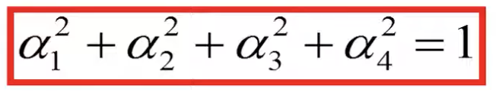
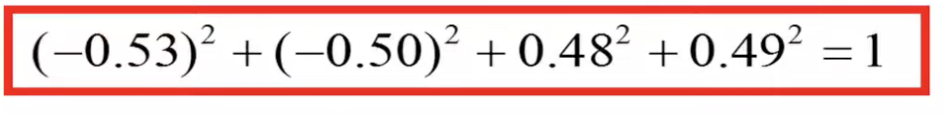
Interpret the weights
Component Matrix
 | PC1 | PC2
Diastolic BP | -0.53 | -0.46
Systolic BP | -0.5 | -0.52
Weight | 0.48 | -0.52
Height | 0.49 | -0.5
Notes:
We see how we can convert these weights to represent correlation coefficients. In the previous calculation, the weights have been computed based on the constraint that the sum of the squared weights should be equal to 1. In our example, this means that the sum of the four squared weights should be equal to 1. If we sum the squared weights of the first principal component, that is equal to 1.

Slide 6



Interpret the weights
Component Matrix
Score
 | PC1 | PC2
Diastolic BP | -0.53 | -0.46
Systolic BP | -0.5 | -0.52
Weight | 0.48 | -0.52
Height | 0.49 | -0.5
PC1 | PC2 | PC3 | PC4
-0.62 | -1.14 | -0.1 | -0.14
1.73 | -1.32 | -0.16 | 0.14
0.26 | -1.35 | 0.65 | 0
-1.05 | 0.06 | -0.09 | 0.46
2.35 | 1.68 | -0.28 | 0
-0.59 | 1.43 | 0.23 | 0.16
-2.47 | -0.06 | -0.4 | -0.17
0.41 | 1.51 | 0.32 | -0.24
-1.58 | 0.19 | 0.03 | -0.09
1.58 | -1 | -0.2 | -0.13
var | 2.41 | 1.45 | 0.1 | 0.04
 | PC1 | PC2
Diastolic BP | -0.82 | -0.55
Systolic BP | -0.77 | -0.62
Weight | 0.75 | -0.63
Height | 0.77 | -0.6
Notes:
However, we can use another constraint, where the sum of the squared weights should be equal to variance (or eigenvalue) of the corresponding principal component.
For example, we could scale the weights for principal component 1 so that the sum of the squared weights is equal to 2.41. To rescale the weights, which correspond to the eigenvectors, we can multiple these by the square root of the corresponding eigenvalue. Then we get the following weights, which are called loadings. For example, this loading value is calculated by multiplying the value of this weight by the square root of the variance of principal component 1. Note that this variance is equal to the eigenvalue associated with the first eigenvector. If we sum these squared loadings for PC1, we will get the variance for the scores of PC1 and so on.

Slide 7
Interpret the weights
Data matrix (standardized data)
Score
Diastolic BP | Systolic BP | Weight | Height
(mm Hg) | (mm Hg) | (kg) | (cm)
0.93 | 0.82 | 0.21 | 0.36
-0.43 | -0.05 | 1.43 | 1.6
0.58 | 0.46 | 1.28 | 0.36
0.19 | 0.82 | -0.55 | -0.57
-2.05 | -1.98 | 0.06 | 0.51
-0.43 | -0.37 | -0.85 | -1.19
1.39 | 1.21 | -1.46 | -0.88
-0.7 | -1.19 | -0.39 | -0.73
0.81 | 0.62 | -0.85 | -0.88
-0.31 | -0.33 | 1.12 | 1.44
PC1 | PC2 | PC3 | PC4
-0.62 | -1.14 | -0.1 | -0.14
1.73 | -1.32 | -0.16 | 0.14
0.26 | -1.35 | 0.65 | 0
-1.05 | 0.06 | -0.09 | 0.46
2.35 | 1.68 | -0.28 | 0
-0.59 | 1.43 | 0.23 | 0.16
-2.47 | -0.06 | -0.4 | -0.17
0.41 | 1.51 | 0.32 | -0.24
-1.58 | 0.19 | 0.03 | -0.09
1.58 | -1 | -0.2 | -0.13
 | PC1 | PC2
Diastolic BP | -0.82 | -0.55
Systolic BP | -0.77 | -0.62
Weight | 0.75 | -0.63
Height | 0.77 | -0.6
Notes:
These loadings correspond to the Pearson correlation coefficients between the original data and the principal component scores when the PCA is based on standardized data.
For example, if we create a scatter plot between the standardized diastolic blood pressure values and the scores of PC1, and compute the Pearson correlation coefficient, that coefficient would be equal to -0.82.
Note that we will get the same correlation between the unstandardized data and PC1 because standardizing the variables does not affect their correlation. This helps us to interpret the weights because the weights represent the correlation between the original variables and the principal components.

Slide 8
Varimax rotation
Component Matrix
Score
 | PC1 | PC2
Diastolic BP | -0.53 | -0.46
Systolic BP | -0.5 | -0.52
Weight | 0.48 | -0.52
Height | 0.49 | -0.5
PC1 | PC2 | PC3 | PC4
-0.62 | -1.14 | -0.1 | -0.14
1.73 | -1.32 | -0.16 | 0.14
0.26 | -1.35 | 0.65 | 0
-1.05 | 0.06 | -0.09 | 0.46
2.35 | 1.68 | -0.28 | 0
-0.59 | 1.43 | 0.23 | 0.16
-2.47 | -0.06 | -0.4 | -0.17
0.41 | 1.51 | 0.32 | -0.24
-1.58 | 0.19 | 0.03 | -0.09
1.58 | -1 | -0.2 | -0.13
Var | 2.41 | 1.45 | 0.1 | 0.04
% var | 60.20% | 36.20% | 2.50% | 1.10%
Cum % | 60.20% | 96.40% | 98.90% | 100%
Notes:
Varimax rotation is the method that increases the interpretation of our weights or loadings. One aim of PCA is to study which variables that are associated to which principal component. If we study the absolute values of the weights for the first component, we see that all absolute values are around 0.5. The same is also true for the weights associated with the second component. By using the absolute values, it is impossible to tell which variables that are associated to PC1 or PC2.
We have seen that PCA combines the variables in a way that maximizes the variance of the first principal components which is good when we like to reduce the dimensions, but bad if we like to interpret the components. Once we have identified the number of components to extract, we can rotate them to better understand what they present. For example, we use Varimax rotation only on the first two components. One common rotation method to use in order to increase the interpretation of the weights is to use the so-called Varimax rotation.

Slide 9
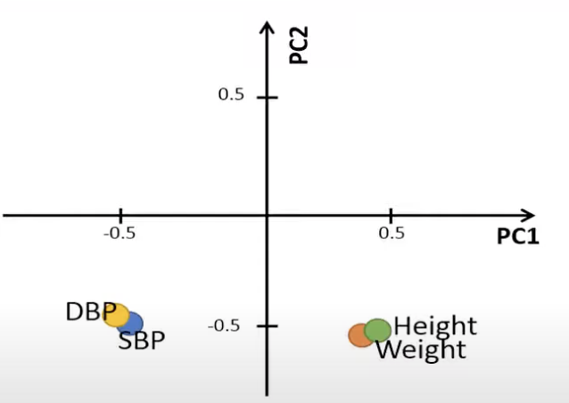
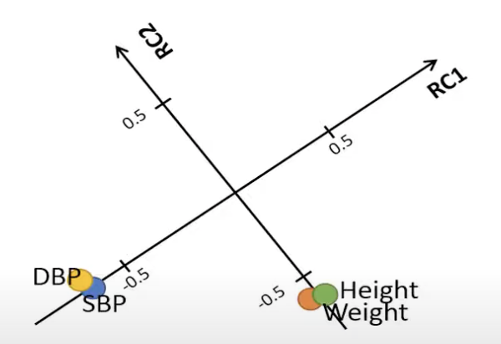
Varimax rotation
Component Matrix
 | PC1 | PC2
Diastolic BP | -0.53 | -0.46
Systolic BP | -0.5 | -0.52
Weight | 0.48 | -0.52
Height | 0.49 | -0.5
After varimax rotation
 | RC1 | RC2
Diastolic BP | -0.7 | 0.04
Systolic BP | -0.72 | -0.02
Weight | -0.02 | -0.71
Height | 0 | -0.7
Cutoff value = 0.65
Diastolic and Systolic load on component 1
Weight and Height load on component 2
Notes:
Now we discuss how it works with a simple plot. If we plot the values of the weights for PC1 and PC2, we get this plot. Note that all four variables have the same value of the weights associated with PC2. In contrast, the variables diastolic and systolic blood pressure are associated with negative weights for PC1 whereas weight and height have positive values.
Varimax rotation is a method to help us to interpret the weights. One can think of this method as we rotate the axes so that the absolute values of the weights either become close to one or zero. Let’s say that we would rotate the axes counter clockwise like this. In this new coordinate system, the values of the weights will change. Now we call the components “rotated component” instead of principal components. For example, we see that the weights associated with the diastolic and systolic blood pressure are -0.7 whereas the weights for the body weight and height are close to 0 when we focus on the first component. In contrast, the variables body weight and height have a relatively high absolute value of the weights associated with the rotated component 2. Varimax rotation is easy to identify a connection between the rotated components and the variables.

Slide 10
Varimax rotation
Eigenvectors/ weights
Loadings
 | PC1 | PC2
Diastolic BP | -0.53 | -0.46
Systolic BP | -0.5 | -0.52
Weight | 0.48 | -0.52
Height | 0.49 | -0.5
 | PC1 | PC2
Diastolic BP | -0.82 | -0.55
Systolic BP | -0.77 | -0.62
Weight | 0.75 | -0.63
Height | 0.77 | -0.6
After varimax rotation
After varimax rotation
 | RC1 | RC2
Diastolic BP | -0.7 | 0.04
Systolic BP | -0.72 | -0.02
Weight | -0.02 | -0.71
Height | 0 | -0.7
 | RC1 | RC2
Diastolic BP | -0.97 | 0.18
Systolic BP | -0.98 | 0.1
Weight | 0.09 | -0.97
Height | 0.12 | -0.97
Notes:
The loadings values in this table then correspond to the Pearson correlation coefficients between the given principal component and variables. After varimax rotation, we have the following loadings, which represent the correlations between the variables and the Varimax rotated scores.

Slide 11
Varimax rotation
Standardized Scores
Rotated Standardized Scores
PC1 | PC2
-0.4 | -0.95
1.11 | -1.1
0.16 | -1.12
-0.68 | 0.05
1.51 | 1.39
-0.38 | 1.19
-1.59 | -0.05
0.26 | 1.25
-1.02 | 0.16
1.02 | -0.83
var = 1 | var = 1
RC1 | RC2
-0.95 | -0.39
0.02 | -1.56
-0.67 | -0.91
-0.45 | 0.51
2.06 | -0.07
0.56 | 1.11
-1.17 | 1.08
1.07 | 0.71
-0.61 | 0.83
0.14 | -1.3
var = 1 | var = 1
Rotation matrix
0.71 | -0.7
0.7 | 0.71
X
=
Notes:
The variance of these Varimax rotated scores is 1 because the scores have been standardized.

Slide 12
Varimax rotation
Rotated Standardized Scores
Rotated Standardized Scores
RC1 | RC2
-0.95 | -0.39
0.02 | -1.56
-0.67 | -0.91
-0.45 | 0.51
2.06 | -0.07
0.56 | 1.11
-1.17 | 1.08
1.07 | 0.71
-0.61 | 0.83
0.14 | -1.3
var = 1 | var = 1
 | RC1 | RC2 | SUM
var | 1.94 | 1.92 | 3.86
 | PC1 | PC2 | SUM
var | 2.41 | 1.45 | 3.86
Notes:
However, by using a software, it can provide us with the variance for the rotated unstandardized scores. The variances of the two rotated components are quite similar. As we have seen before, if we multiply the square root of the variance, which is the standard deviation, by the corresponding scores, we will get the unstandardized scores.
If we compare the variance of the rotated component scores with the principal component scores, we see that the first principal component has much more variance compared to the second principal component. In contrast, the variance of the rotated components are the same because Varimax rotation does not rotate to maximize the variance of the first component. It rotates data to increase the interpretation. Although the component scores have different variance after Varimax rotation, the total variance hasn’t changed.

Slide 13
Varimax rotation
Rotated Standardized Scores
RC1 | RC2
-0.95 | -0.39
0.02 | -1.56
-0.67 | -0.91
-0.45 | 0.51
2.06 | -0.07
0.56 | 1.11
-1.17 | 1.08
1.07 | 0.71
-0.61 | 0.83
0.14 | -1.3
var = 1 | var = 1
Diastolic BP | Systolic BP | Weight | Height
(mm Hg) | (mm Hg) | (kg) | (cm)
0.93 | 0.82 | 0.21 | 0.36
-0.43 | -0.05 | 1.43 | 1.6
0.58 | 0.46 | 1.28 | 0.36
0.19 | 0.82 | -0.55 | -0.57
-2.05 | -1.98 | 0.06 | 0.51
-0.43 | -0.37 | -0.85 | -1.19
1.39 | 1.21 | -1.46 | -0.88
-0.7 | -1.19 | -0.39 | -0.73
0.81 | 0.62 | -0.85 | -0.88
-0.31 | -0.33 | 1.12 | 1.44
 | RC1 | RC2
Diastolic BP | -0.97 | 0.18
Systolic BP | -0.98 | 0.1
Weight | 0.09 | -0.97
Height | 0.12 | -0.97
Notes:
The loadings after Varimax rotation correspond to the correlation between the rotated scores and variables.
For example, the Pearson correlation coefficient between the rotated scores of the first component and the diastolic blood pressure is -0.97 and the correlation between the rotated component 2 and the body weight is also -0.97

Slide 14
References
https://www.youtube.com/watch?v=BiuwDI_BbWw&t=4s

Slide 15
Thank you

